Slide 1


STAAR Test is Monday!!
Let’s get ready…

Slide 2
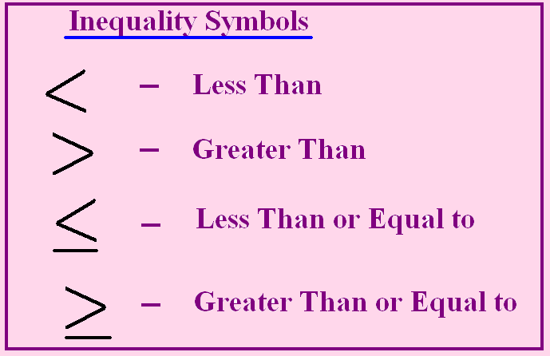
Your Left hand makes a Less Than

Slide 3
Remember….
When you multiply or divide
an inequality by a negative,
you must flip the inequality
sign!!

Slide 4
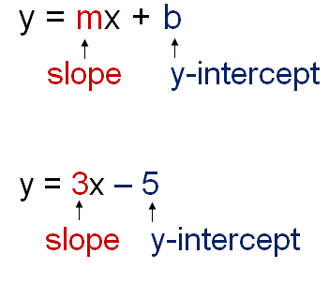
Slope-Intercept Form of a Line
b is where you Begin
m is where you Move from there!

Slide 5
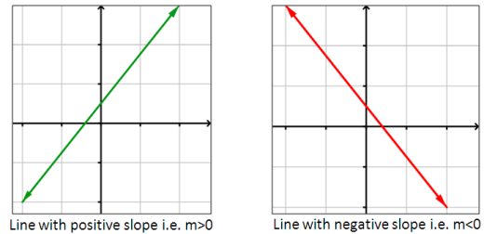
As the line moves from left to right….
Positive slopes go up, negative slopes go down.

Slide 6
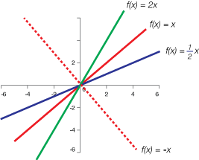
Look at slopes…. the bigger the slope, the steeper the line.

Slide 7
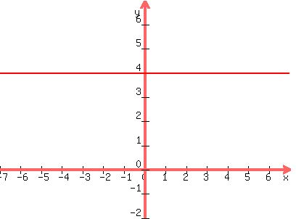
Horizontal Lines
What is the slope of this line?
What is its equation?

Slide 8
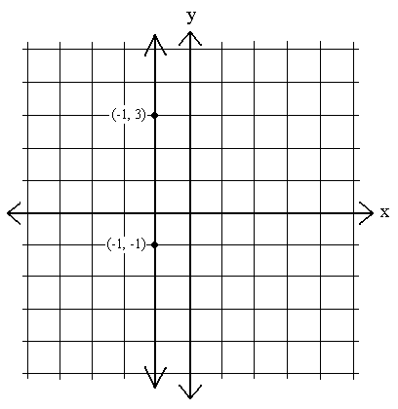
Vertical Lines
What is the slope of this line?
What is its equation?

Slide 9
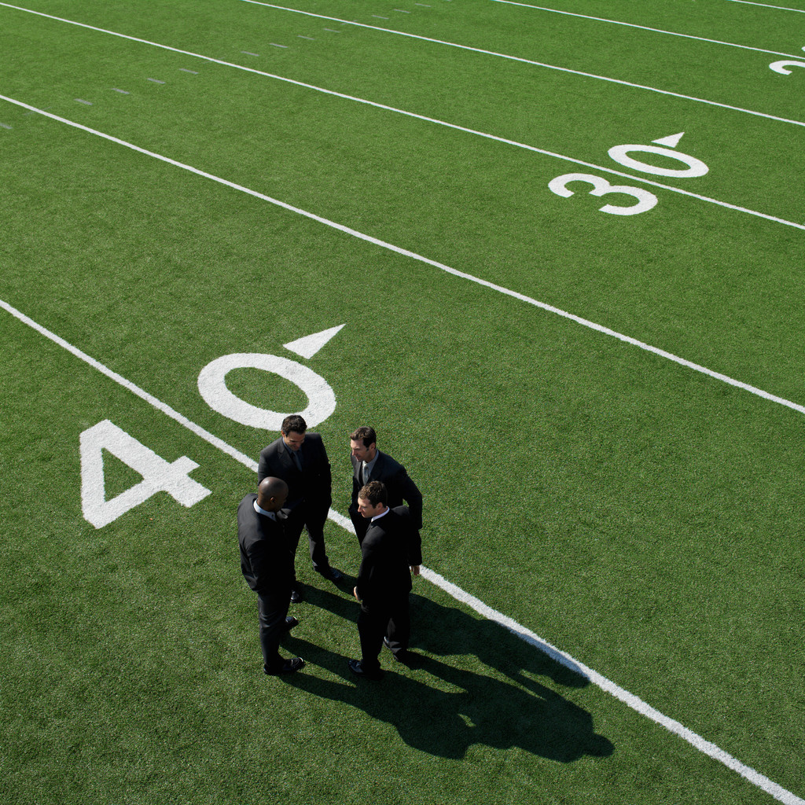


“The number one problem that keeps people from winning … is lack of belief in themselves.” ~ Arthur L. Williams

Slide 10
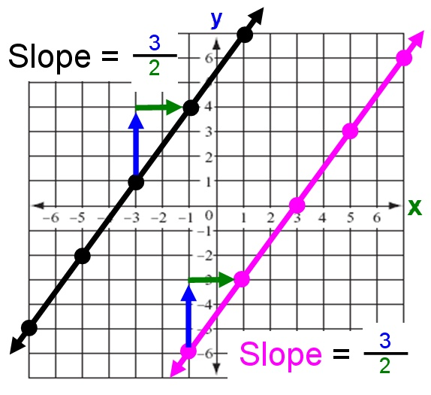
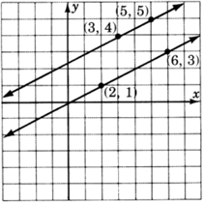
Parallel Lines have equal slopes!

Slide 11
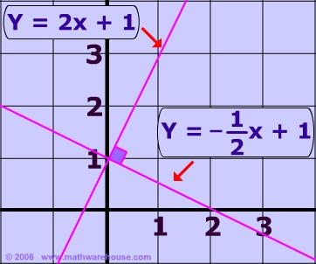
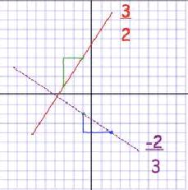
Perpendicular Lines
“Opposite Reciprocal”slopes

Slide 12
Systems of Linear Equations
One Solution
No Solutions
Infinitely Many Solutions

Slide 13
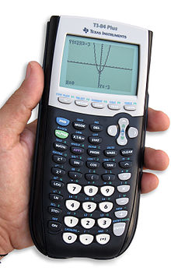
Solving Systems on the Calculator
Put the 1st equation in y₁
Put the 2nd equation in y₂
Graph it.
2nd trace
5
Enter, enter, enter

Slide 14
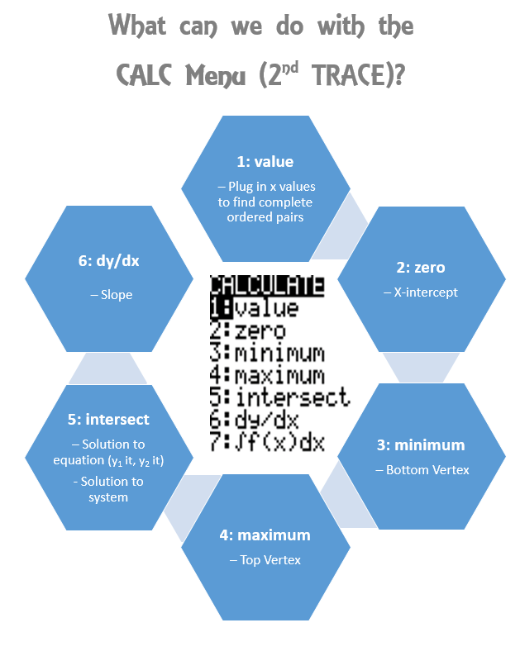

Slide 15
What is a function?
Each x value has one and only one y value.
X | Y
1 | -4
4 | -1
8 | 2
10 | 6
(1,4), (2,6), (4,8), (7,10)
Each girl can only have one guy!!

Slide 16
What is not a function?
X | Y
1 | 4
1 | 5
2 | 6
3 | 7
(2,3), (3,3), (5,9), (5,8), (6,7)
The x’s can’t repeat!!

Slide 17

Domain and Range
D R
X Y
I D

Slide 18


“Many of life's failures are people who did not realize how close they were to success when they gave up.” ~ Thomas Edison

Slide 19
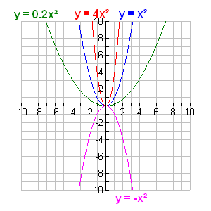
Quadratic Functions
As the “a” gets bigger, the parabola gets NARROWER.
A negative “a” flips the parabola over!!

Slide 20
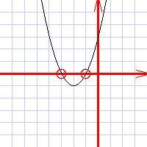
What are the solutions?
Roots
zerOs
X-intercepts
Solutions

Slide 21
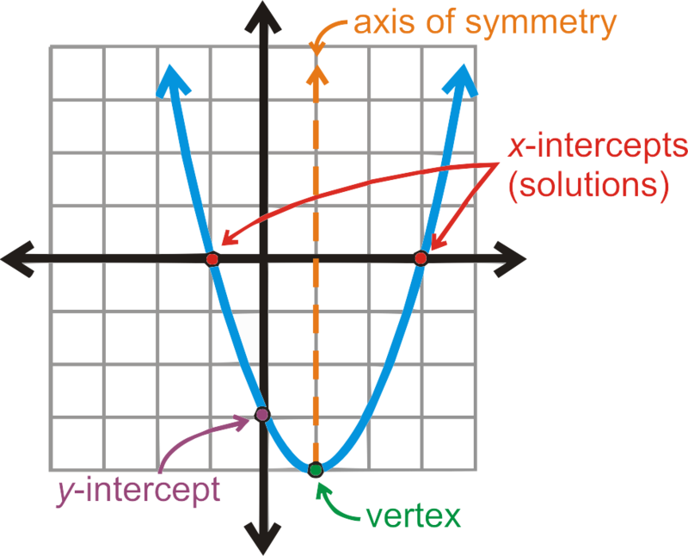
Characteristics of a Quadratic Function
ROXS

Slide 22
“Success is dependent on effort.”
Sophocles (496-406)
What is the independent quantity?
(What happens first?)
What is the dependent quantity?
(What happens next?)

Slide 23
Independent variable is……
In – de – problem!!
Y = 3x + 7
C = 4d – 1
D = rt

Slide 24
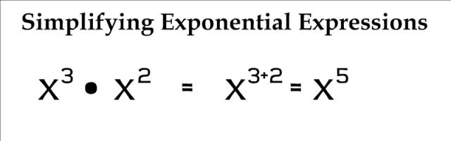
Exponent Rules….
When you multiply---add exponents

Slide 25
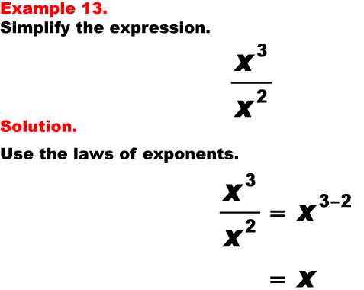
Exponent Rules…..
When you divide---Subtract exponents

Slide 26
Exponent Rules…..
When you raise a power to a power---multiply exponents
(x²)³ = x⁶
(m⁴n⁵)² = m⁸n¹⁰
Work numbers first,
Then the x’s,
Then the y’s,
Then the z’s.
Check answer
choices after
each step

Slide 27
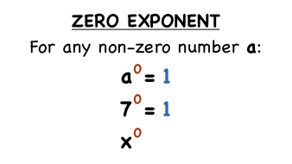
Anything raised to the power of zero is:
ONE!!

Slide 28

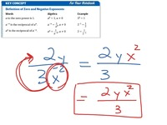
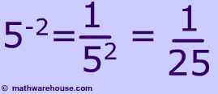
Negative Exponents
“Make all exponents Happy!”

Slide 29

“If we did all the things we are capable of doing, we would literally astound ourselves.”~ Thomas A. Edison

Slide 30
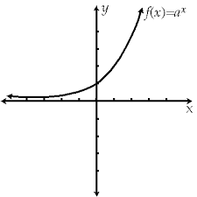
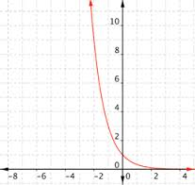
Exponential Functions
Exponential Growth
Exponential Decay

Slide 31
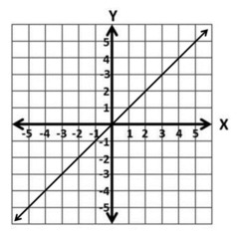
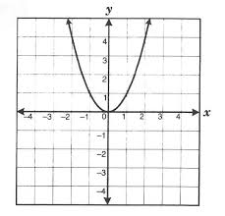
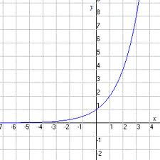
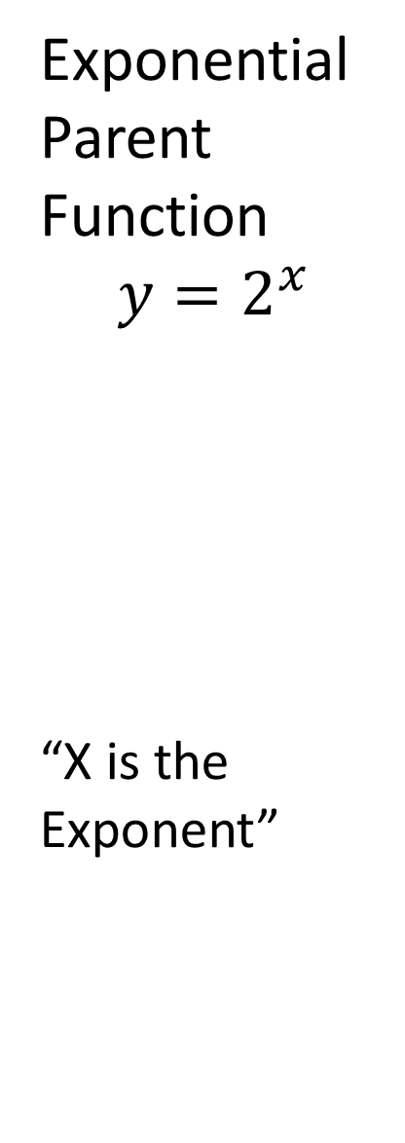
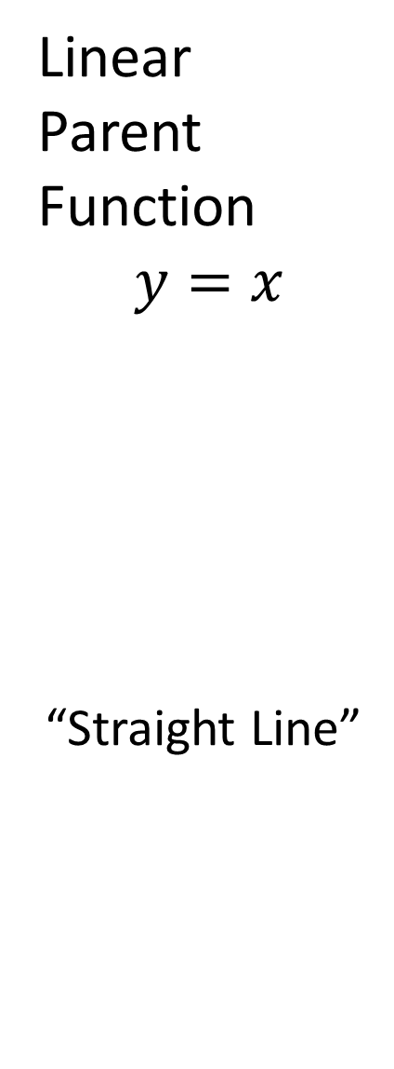
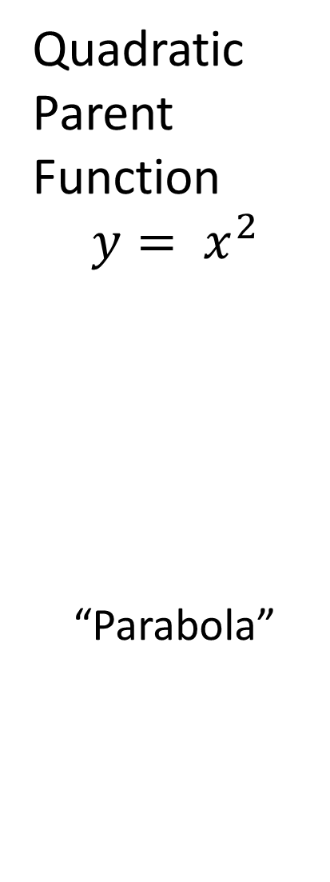
Parent Functions
Linear Parent Function
$y=x$
“Straight Line”
Quadratic Parent Function
$$y= x^{2}$$
“Parabola”
Exponential Parent Function
$$y=2^{x}$$
“X is the Exponent”

Slide 32
Does the problem have an equation in it???
y = Blah Blah Blah
Or
f(x) = Blah Blah Blah
Then plug it into Y=!!!!
You can use either GRAPH , TABLE , or
2nd Trace… to find the answer.

Slide 33
Do you know how to reset your calculator?
2nd
Plus sign
7
All
2

Slide 34
Or turn on the correlation coefficient?
Mode
Stat Diagnostics
Highlight On and hit Enter

Slide 35
EOC Testing
Some quick reminders of what to expect…

Slide 36
Before test day
Know your testing location
  Ask your teachers if you don’t know where to go
  Find your name on the rosters in the commons
  Still not sure where to go? Ask someone for help!
Get a good night’s sleep

Slide 37
The morning of the test
Be in dress code
  Show your Gander Pride by wearing a maroon shirt
  No pajamas, slippers, pillows or blankets
  Some testing rooms are cold: be prepared and dress in layers
Wear your ID badge
Eat a good breakfast
  It is FREE in the Cafeteria
Grab a good book to read after the test
  School appropriate, of course
  Must be a book, not an e-reader
Be ON TIME

Slide 38
Once you arrive to the testing room
Put your personal belongings at the front of the class
  No purses or backpacks can be at your desk
Sit in the desk directed by your testing teacher
Turn in your cell phone and iPad
  Complete the Electronic Device contract
  Label, power down and turn in your device(s)
  All electronic devices will be in locked storage until testing is complete

Slide 39
During testing
Show what you know – you have been working for this day all year!
  Read all of the questions carefully and use your strategies
You cannot have food or drink at your desk
If you need to see the nurse, you must be escorted by an adult
You cannot access your personal belongings during the test, so make sure you have your lunch money, etc. with you at your desk
Remain seated and signal the teacher if you need anything

Slide 40
After you are finished
Look over your test booklet and answer document to confirm you have completed all parts of the test
Signal your testing teacher when you are ready to turn in your materials
  This includes all scratch paper. If you use it for drawing, it will be collected and destroyed after testing.
Read your book quietly
Remain seated and do not disturb others that are working

Slide 41
STAAR Test is Monday!!
I know you
are ready!!

